Slide 1
Age Groups Affected by Drugs & Alcohol in the Top 5 Death Rate States
By Team Reaganomics: Zach Schwartz, Jenna Monchamp, Che-An (Andy) Lin, Lordia Larbi-Asare

Slide 2
Background
Late 1990’s saw pharmaceutical companies pushing the use of opioids as pain relievers.
Healthcare providers prescribed opioids to patients with the reassurance that the drugs were not addictive.
Drug and alcohol abuse is one of the leading cause of deaths in the United States.

Slide 3
Definition of Terms & Variables
States - Top 5 States with drug and alcohol related deaths
Age Groups
Ages <1 to 85+ separated into 10 year segments
R-squared value
The value that measures how close the data are fitted to the regression line
Correlation value
The value that determines the relationship between X and Y. In this case, they are the number of deaths and causes of death in each age group.

Slide 4
Questions
What are the top 5 states with drug/ alcohol induced deaths?
What are the death rates for each age range?
How does each age range drug induced deaths compared to their alcohol induced deaths?
Hypothesis
As the age range increases, then so does the number of drug/ alcohol induced deaths.

Slide 5
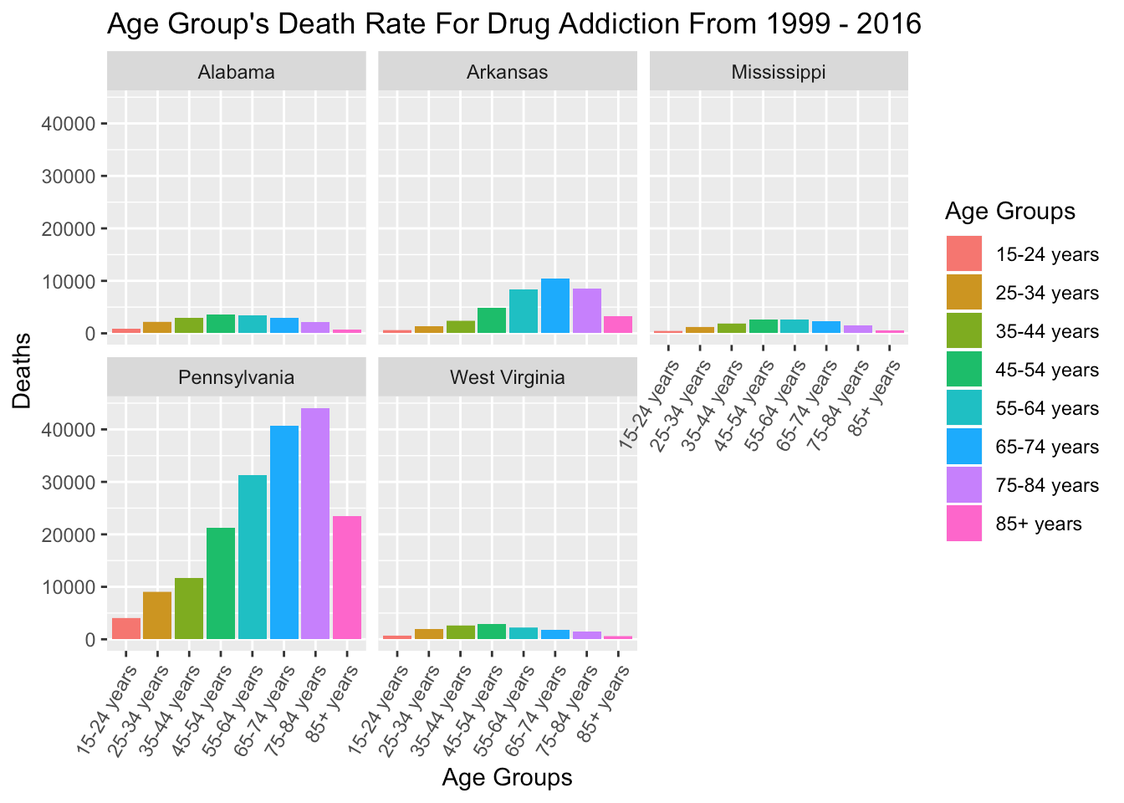
Age Group’s Deaths Rate Caused by Drug Addiction/Overdose
Death count by age group
West Virginia and Pennsylvania show steady increase through higher age groups.
Age range of 65-84 have highest death rates for the five states

Slide 6
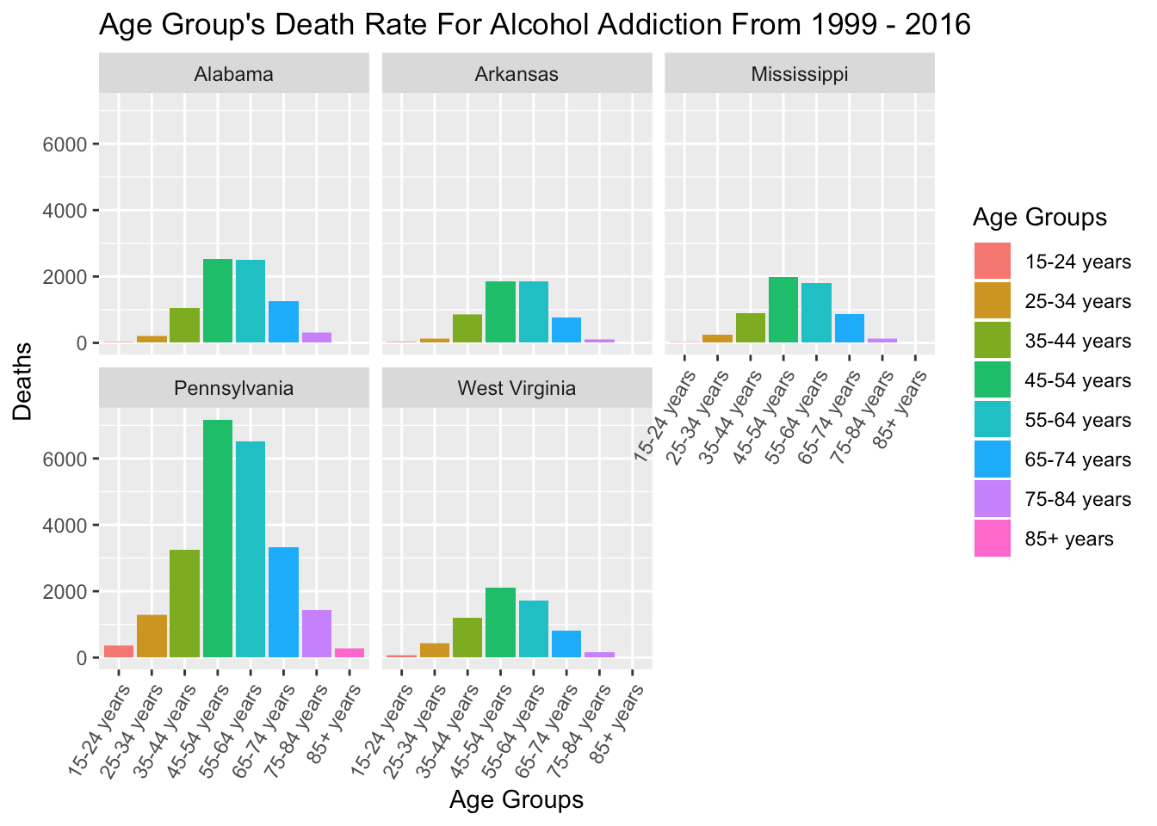
Age Group’s Death Rate caused by Alcohol Addiction
Death counts by age group
Each graph shows a bell curve
Age range of 45-64 have highest death rate across the five states

Slide 7
Key Values for the Regression Analysis
Causes of Deaths / Key Values | Alcohol | Drug
R-Squared Values | 0.1438 | 0.1525
Correlation Values: | 0.0989 | 0.1985

Slide 8
Conclusion
The Top 5 States are Pennsylvania, Alabama, Arkansas, West Virginia, Mississippi with the highest death rates from drug/alcohol.
Deaths from Drug overdose follows closely to our hypothesis, while death by alcohol follows a more normally distributed bell curve over the age ranges
We can conclude from the regression analysis that drugs have a slightly higher impact on the death rate than alcohol

Slide 9
Citations
Centers for Disease Control and Prevention. (2017). Multiple Causes of Death Data. Retrieved from https://wonder.cdc.gov/mcd.html
Centers for Disease Control and Prevention
The Treatment Center . “ Arkansas drug and alcohol addiction epidemic” https://www.thetreatmentcenter.com/resources/drug-facts-by-state/arkansas/
Substance Abuse Among Older Adults: Treatment Improvement Protocol(TIP) Series 26. http://adaiclearinghouse.org/downloads/TIP-26-Substance-Abuse-Among-Older-Adults-67.pdf

